Slide 1

Markov Chains:
Applications in Music
Sai Sruthi Talluri (201301143)
Zarana Parekh (201301177)
Ruchi Jain (201301186)
Khyati Mahajan (201301406)

Slide 2
Generating music using Markov Chains
Markov Chains are a sequence of random numbers, where the current random number only depends on one previous state. In the domain of music, it can be used to predict the notes of a song, given that it has had a song to work on before. In essence, it allows for some amount of machine learning probabilistic modeling of music.
With the notes of the input song, we can construct an adjacency matrix for a Markov Chain by calculating the probabilities of the occurrence of a note, depending on its previous note. The output is a clear, noiseless melody which is similar to the one given as the input.

Slide 3
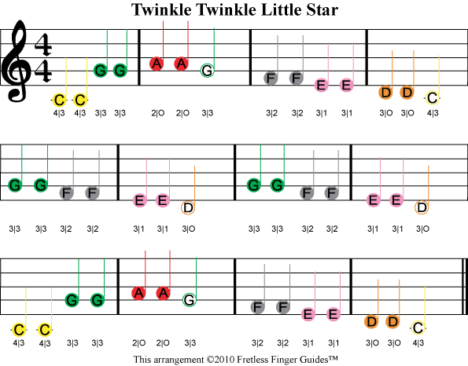
The input sample
Let’s take the sample music to be Twinkle Twinkle.
We then create an adjacency matrix for
successive notes, which constitutes
the Markov Chain.
The Markov Chain then outputs a melody based on these probabilities of playing one note, given the previous note. This leads us to produce a melody.

Slide 4
 | a | a# | b | c | c# | d | d# | e | f | f# | g | g#
a | 2 | 0 | 0 | 0 | 0 | 0 | 0 | 0 | 0 | 0 | 2 | 0
a# | 0 | 0 | 0 | 0 | 0 | 0 | 0 | 0 | 0 | 0 | 0 | 0
b | 0 | 0 | 0 | 0 | 0 | 0 | 0 | 0 | 0 | 0 | 0 | 0
c | 0 | 0 | 0 | 2 | 0 | 0 | 0 | 0 | 0 | 0 | 3 | 0
c# | 0 | 0 | 0 | 0 | 0 | 0 | 0 | 0 | 0 | 0 | 0 | 0
d | 0 | 0 | 0 | 1 | 0 | 2 | 0 | 0 | 0 | 0 | 1 | 0
d# | 0 | 0 | 0 | 0 | 0 | 0 | 0 | 0 | 0 | 0 | 0 | 0
e | 0 | 0 | 0 | 0 | 0 | 4 | 0 | 4 | 0 | 0 | 0 | 0
f | 0 | 0 | 0 | 0 | 0 | 0 | 0 | 4 | 4 | 0 | 0 | 0
f# | 0 | 0 | 0 | 0 | 0 | 0 | 0 | 0 | 0 | 0 | 0 | 0
g | 2 | 0 | 0 | 0 | 0 | 0 | 0 | 0 | 4 | 0 | 4 | 0
g# | 0 | 0 | 0 | 0 | 0 | 0 | 0 | 0 | 0 | 0 | 0 | 0
Adjacency matrix for the occurrence of notes in Twinkle Twinkle

Slide 5
Adjacency matrix for the occurrence of next note timings in Twinkle Twinkle
 | 1 | 2 | 4 | 8 | 16
1 | 0 | 0 | 0 | 0 | 0
2 | 0 | 0 | 3 | 0 | 0
4 | 0 | 4 | 20 | 0 | 0
8 | 0 | 0 | 0 | 0 | 0
16 | 0 | 0 | 0 | 0 | 0

Slide 6
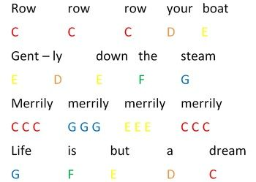
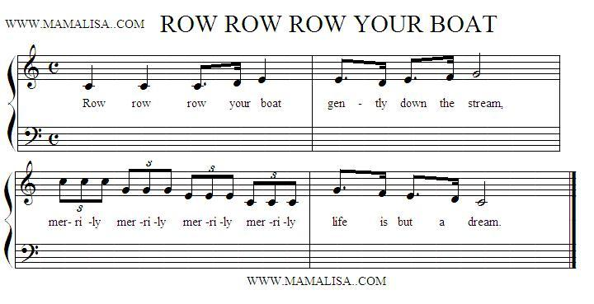
 | a | a# | b | c | c# | d | d# | e | f | f# | g | g#
a | 0 | 0 | 0 | 0 | 0 | 0 | 0 | 0 | 0 | 0 | 0 | 0
a# | 0 | 0 | 0 | 0 | 0 | 0 | 0 | 0 | 0 | 0 | 0 | 0
b | 0 | 0 | 0 | 0 | 0 | 0 | 0 | 0 | 0 | 0 | 0 | 0
c | 0 | 0 | 0 | 6 | 0 | 1 | 0 | 0 | 0 | 0 | 2 | 0
c# | 0 | 0 | 0 | 0 | 0 | 0 | 0 | 0 | 0 | 0 | 0 | 0
d | 0 | 0 | 0 | 1 | 0 | 0 | 0 | 2 | 0 | 0 | 0 | 0
d# | 0 | 0 | 0 | 0 | 0 | 0 | 0 | 0 | 0 | 0 | 0 | 0
e | 0 | 0 | 0 | 0 | 0 | 2 | 0 | 3 | 1 | 0 | 0 | 0
f | 0 | 0 | 0 | 0 | 0 | 0 | 0 | 1 | 0 | 0 | 1 | 0
f# | 0 | 0 | 0 | 0 | 0 | 0 | 0 | 0 | 0 | 0 | 0 | 0
g | 0 | 0 | 0 | 1 | 0 | 0 | 0 | 1 | 1 | 0 | 0 | 0
g# | 0 | 0 | 0 | 0 | 0 | 0 | 0 | 0 | 0 | 0 | 0 | 0
Adjacency matrix for Row Row Row Your Boat

Slide 7
Applications
Used in comparing similarity in the music tunes
Remix songs by giving both as initial input
Complete music notes given an initial tune to begin with
Used in malls entertainment centers - auto complete piano tunes etc

Slide 8
References
http://peabody.sapp.org/class/dmp2/lab/markov1/
http://collected.jcu.edu/cgi/viewcontent.cgi?article=1001&context=honorspapers
https://dzone.com/articles/algorithm-week-generate-music
http://www.vikparuchuri.com/blog/making-instrumental-music-from-scratch/

